Slide 1
Sorting and Searching
Prepared By:
Jyotsnarani Tripathy

Slide 2
Linear Search
#include <stdio.h>
int main()
{
int a[10], i, item;
printf("\nEnter SEVEN elements of an array:\n");
for (i=0; i<=6; i++)
scanf("%d", &a[i]);
printf("\nEnter item to search: ");

Slide 3
Cont…
scanf("%d", &item);
for (i=0; i<=6; i++)
if (item == a[i])
{
printf("\nItem found at location %d", i+1);
break;
}
if (i > 9)
printf("\nItem does not exist.");
return 0;
}

Slide 4
LS Algorithm
Step 1 - Read the search element from the user.
Step 2 - Compare the search element with the first element in the list.
Step 3 - If both are matched, then display "Given element is found!!!" and terminate the function
Step 4 - If both are not matched, then compare search element with the next element in the list.
Step 5 - Repeat steps 3 and 4 until search element is compared with last element in the list.
Step 6 - If last element in the list also doesn't match, then display "Element is not found!!!" and terminate the function.

Slide 5
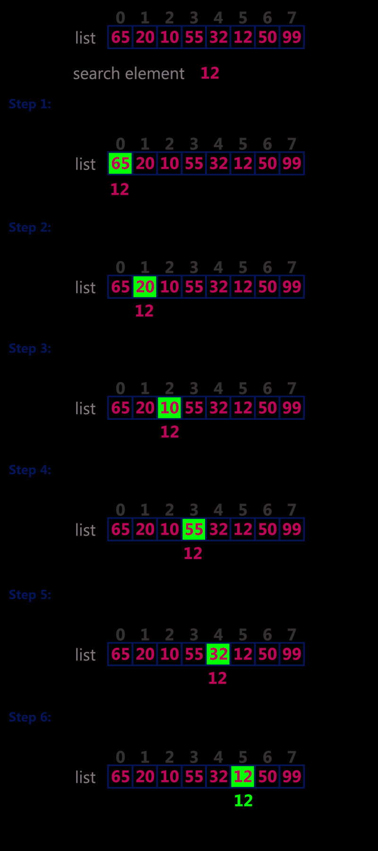

Slide 6
Binary Search
#include <stdio.h>
int main()
{
int c, first, last, middle, n, search, array[100];
printf("Enter number of elements\n");
scanf("%d", &n);
printf("Enter %d integers\n", n);
for (c = 0; c < n; c++)
scanf("%d", &array[c]);
printf("Enter value to find\n");
scanf("%d", &search);
first = 0;
last = n - 1;
middle = (first+last)/2;

Slide 7
Cont..
while (first <= last)
{
if (array[middle] < search)
first = middle + 1;
else if (array[middle] == search) {
printf("%d found at location %d.\n", search, middle+1);
break;
}
else
last = middle - 1;
middle = (first + last)/2;
}
if (first > last)
printf("Not found! %d isn't present in the list.\n", search);
return 0;
}

Slide 8
BS Algorithm
Binary search is implemented using following steps...
Step 1 - Read the search element from the user.
Step 2 - Find the middle element in the sorted list.
Step 3 - Compare the search element with the middle element in the sorted list.
Step 4 - If both are matched, then display "Given element is found!!!" and terminate the function.
Step 5 - If both are not matched, then check whether the search element is smaller or larger than the middle element.

Slide 9
Cont..
Step 6 - If the search element is smaller than middle element, repeat steps 2, 3, 4 and 5 for the left sublist of the middle element.
Step 7 - If the search element is larger than middle element, repeat steps 2, 3, 4 and 5 for the right sublist of the middle element.
Step 8 - Repeat the same process until we find the search element in the list or until sublist contains only one element.
Step 9 - If that element also doesn't match with the search element, then display "Element is not found in the list!!!" and terminate the function.

